Slide 1
Supervised Learning - SVM
Machine Learning
F.J. Planes fplanes@tecnun.es
17/10/2024

Slide 2
Introduction
SVM (Support Vector Machines): decision support boundaries to separate data into different classes.
AT&T Bell Laboratories by Vladimir Vapnik (Vapnik et al. 1997):
“The Support Vector (SV) method is a new general method of function estimation which does not depend explicitly on the dimensionality of input space. It was applied for pattern recognition, regression estimation, and density estimation problems as well as for problems of solving linear operator equations. In this article we describe the general idea of the SV method and present theorems demonstrating that the generalization ability of the SV method is based on factors which classical statistics do not take into account. We also describe the SV method for density estimation in a set of functions defined by a mixture of an infinite number of Gaussians.”

Slide 3
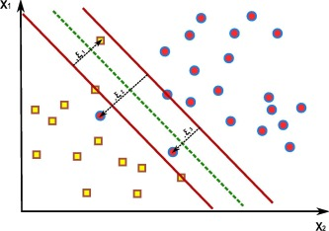
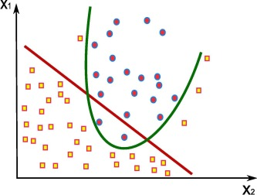
Introduction
Linear and non-linear classification and regression problems
Image classification, text recognition, fraud detection, system recommenders, bioinformatics.

Slide 4



Optimal Separating Hyperplanes
$$f\left(x\right)=β_{0}+β^{T}∙x$$
$$L=\{x:{f\left(x\right)=β}_{0}+β^{T}∙x=0\}$$
$$β_{0}+β^{T}∙x=0$$

Slide 5
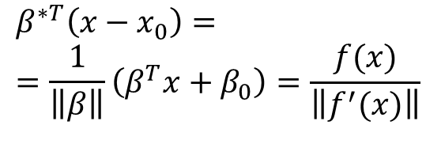






Optimal Separating Hyperplanes
Basic algebra
$$f\left(x\right)=β_{0}+β^{T}x$$
$$L=\{x:{f\left(x\right)=β}_{0}+β^{T}∙x=0\}$$
$$x_{0}$$
Signed distance of any point x to L:
$$x$$
$$β_{0}+β^{T}∙x=0$$
$$β^{∗T}\left(x−x_{0}\right)==\frac{1}{\left\|β\right\|}\left(β^{T}x+β_{0}\right)=\frac{f(x)}{\left\|f^{′}(x)\right\|}$$
$$β^{∗}$$

Slide 6



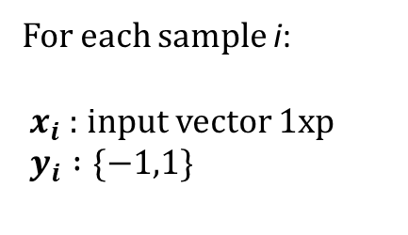



Optimal Separating Hyperplanes
$$max M$$
s.t.
$${y_{i}(β}_{0}+x_{i}^{T}β )≥M, i=1,..,n$$
$$M$$
$\left\|β\right\|$=1
$$M$$
$$β_{0}+β^{T}∙x=0$$
For each sample i:
${ x}_{i}$ : input vector 1xp
$y_{i} :\{−1,1\}$

Slide 7

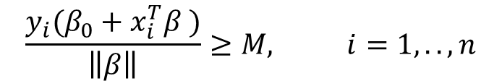


Optimal Separating Hyperplanes
$$max M$$
s.t.
$$\frac{{y_{i}(β}_{0}+x_{i}^{T}β )}{\left\|β\right\|}≥M, i=1,..,n$$
$$M$$
$$M$$
$$β_{0}+β^{T}∙x=0$$
For each sample i:
${ x}_{i}$ : input vector 1xp
$y_{i} :\{−1,1\}$
Non-convex optimization problem

Slide 8
Optimal Separating Hyperplanes
$$max M$$
s.t.
$${y_{i}(β}_{0}+x_{i}^{T}β )≥M\left\|β\right\|, i=1,..,n$$
$$M$$
$$M$$
$$β_{0}+β^{T}∙x=0$$
For each sample i:
${ x}_{i}$ : input vector 1xp
$y_{i} :\{−1,1\}$
Non-convex optimization problem

Slide 9


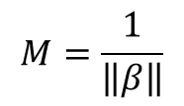
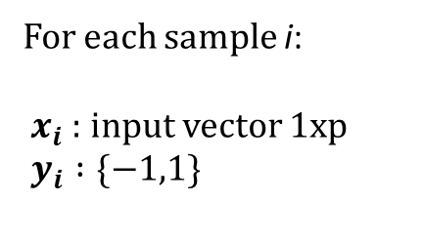
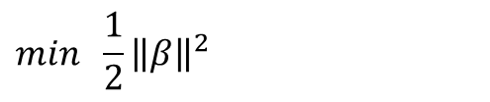

Optimal Separating Hyperplanes
$$min \frac{1}{2}{\left\|β\right\|}^{2}$$
s.t.
$$M$$
$${y_{i}(β}_{0}+x_{i}^{T}β )≥1, i=1,..,n$$
$$M$$
$$β_{0}+β^{T}∙x=0$$
For each sample i:
${ x}_{i}$ : input vector 1xp
$y_{i} :\{−1,1\}$
$$M=\frac{1}{\left\|β\right\|}$$
Convex optimization problem

Slide 10
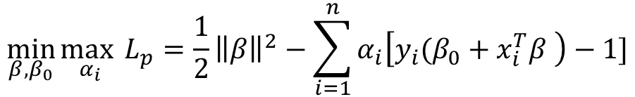
Optimal Separating Hyperplanes
Lagrangian transformation
$$\min_{β,β_{0}}{\max_{α_{i}}{L_{p}=\frac{1}{2}{\left\|β\right\|}^{2}−\sum_{i=1}^{n}{α_{i}\left[{y_{i}(β}_{0}+x_{i}^{T}β \right)−1]}}}$$
s.t.
$$α_{i}≥0, i=1,..,n$$

Slide 11
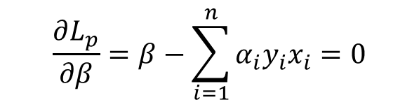

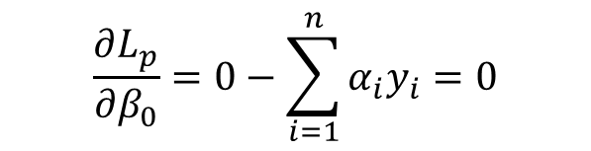
Optimal Separating Hyperplanes
Local and global optimality conditions :
$$\frac{∂L_{p}}{∂β}=β−\sum_{i=1}^{n}{α_{i}y_{i}x_{i}=0}$$
$$\frac{∂L_{p}}{∂β_{0}}=0−\sum_{i=1}^{n}{α_{i}y_{i}=0}$$
$$\frac{∂L_{p}}{∂α_{i}}={{−y}_{i}(β}_{0}+x_{i}^{T}β )+1≤0{{ −→y}_{i}(β}_{0}+x_{i}^{T}β )≥1, i=1,..,n$$
$α_{i} \left[{y_{i}(β}_{0}+x_{i}^{T}β \right)−1]=0$, $i=1,..,n$

Slide 12
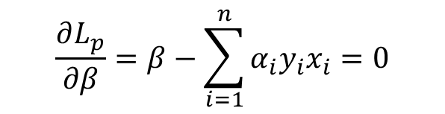

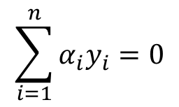
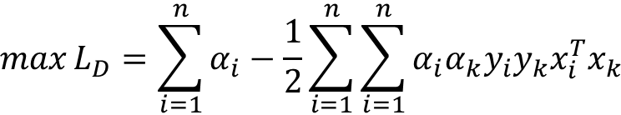

Optimal Separating Hyperplanes
Dual formulation
$$\max{L_{D}=\sum_{i=1}^{n}{α_{i}−\frac{1}{2}\sum_{i=1}^{n}{\sum_{i=1}^{n}{α_{i}α_{k}y_{i}y_{k}x_{i}^{T}x_{k}}}}}$$
s.t.
$$\sum_{i=1}^{n}{α_{i}y_{i}=0}$$
Support points:
$$α_{i}≥0, i=1,..,n$$
$$\frac{∂L_{p}}{∂β}=β−\sum_{i=1}^{n}{α_{i}y_{i}x_{i}=0}$$
$α_{i} \left[{y_{i}(β}_{0}+x_{i}^{T}β \right)−1]=0$, $i=1,..,n$
$$α_{i} >0 −→ \left[{y_{i}(β}_{0}+x_{i}^{T}β \right)−1]=0$$

Slide 13




Optimal Separating Hyperplanes
Support points:
$$α_{i} >0 −→ \left[{y_{i}(β}_{0}+x_{i}^{T}β \right)−1]=0$$
$$M$$
$$M$$
$$β_{0}+β^{T}∙x=0$$

Slide 14
Optimal Separating Hyperplanes
$$max M$$
s.t.
$$\frac{{y_{i}(β}_{0}+x_{i}^{T}β )}{\left\|β\right\|}≥M, i=1,..,n$$
$$M$$
$$M$$
$$β_{0}+β^{T}∙x=0$$
For each sample i:
${ x}_{i}$ : input vector 1xp
$y_{i} :\{−1,1\}$
Non-convex optimization problem

Slide 15
Support Vector Machines
$$max M$$
s.t.
$$\frac{{y_{i}(β}_{0}+x_{i}^{T}β )}{\left\|β\right\|}≥M, i=1,..,n$$
$$M$$
$$M$$
$$β_{0}+β^{T}∙x=0$$
For each sample i:
${ x}_{i}$ : input vector 1xp
$y_{i} :\{−1,1\}$
Non-convex optimization problem

Slide 16
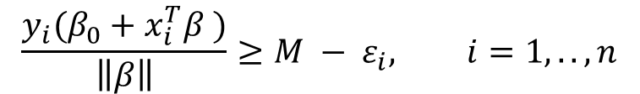


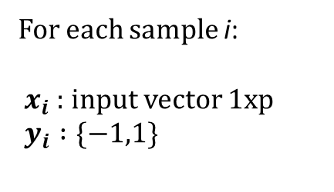


Support Vector Machines
$$max M$$
s.t.
$$M$$
$$\frac{{y_{i}(β}_{0}+x_{i}^{T}β )}{\left\|β\right\|}≥M − ε_{i}, i=1,..,n$$
$$M$$
$$β_{0}+β^{T}∙x=0$$
$ε_{i} ≥0$ $, i=1,..,n$
For each sample i:
${ x}_{i}$ : input vector 1xp
$y_{i} :\{−1,1\}$
Convex optimization problem
Non-convex optimization problem

Slide 17
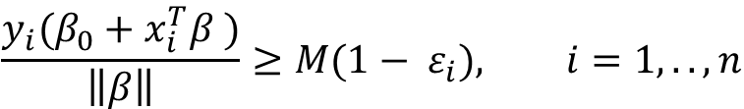

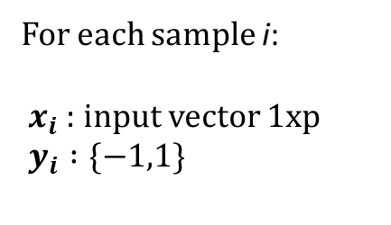



Support Vector Machines
$$max M$$
$$ε_{i}$$
s.t.
$$M$$
$$\frac{{y_{i}(β}_{0}+x_{i}^{T}β )}{\left\|β\right\|}≥M(1− ε_{i}), i=1,..,n$$
$$M$$
$$β_{0}+β^{T}∙x=0$$
$$ε_{i}$$
$ε_{i} ≥0$ $, i=1,..,n$
For each sample i:
${ x}_{i}$ : input vector 1xp
$y_{i} :\{−1,1\}$
Non-convex optimization problem

Slide 18
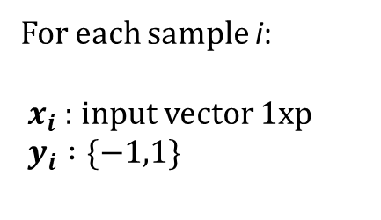

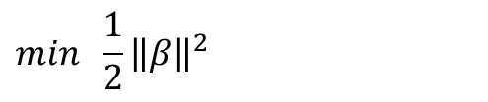



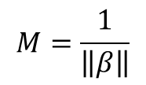
Support Vector Machines
$$min \frac{1}{2}{\left\|β\right\|}^{2}$$
s.t.
$$ε_{i}$$
$${y_{i}(β}_{0}+x_{i}^{T}β )≥1−ε_{i}, i=1,..,n$$
$$M$$
$ε_{i} ≥0$ $, i=1,..,n$
$$M$$
$$β_{0}+β^{T}∙x=0$$
$$ε_{i}$$
For each sample i:
${ x}_{i}$ : input vector 1xp
$y_{i} :\{−1,1\}$
Convex optimization problem
$$M=\frac{1}{\left\|β\right\|}$$

Slide 19
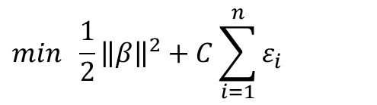

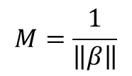
Support Vector Machines
Primal Formulation
$$min \frac{1}{2}{\left\|β\right\|}^{2}+C\sum_{i=1}^{n}{ε_{i}}$$
$$ε_{i}$$
$$M$$
s.t.
$${y_{i}(β}_{0}+x_{i}^{T}β )≥1−ε_{i}, i=1,..,n$$
$$M$$
$$β_{0}+β^{T}∙x=0$$
$$ε_{i}$$
$ε_{i} ≥0$ $, i=1,..,n$
For each sample i:
${ x}_{i}$ : input vector 1xp
$y_{i} :\{−1,1\}$
Convex optimization problem
$$M=\frac{1}{\left\|β\right\|}$$

Slide 20
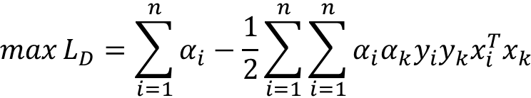
Support Vector Machines
Dual formulation
$$\max{L_{D}=\sum_{i=1}^{n}{α_{i}−\frac{1}{2}\sum_{i=1}^{n}{\sum_{i=1}^{n}{α_{i}α_{k}y_{i}y_{k}x_{i}^{T}x_{k}}}}}$$
s.t.
$$\sum_{i=1}^{n}{α_{i}y_{i}=0}$$
$${0≤α}_{i}≤C, i=1,..,n$$

Slide 21
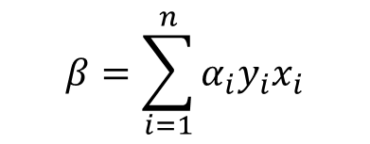

Support Vector Machines
Optimal Solution:
$$β=\sum_{i=1}^{n}{α_{i}y_{i}x_{i}}$$
$α_{i} \left[{y_{i}(β}_{0}+x_{i}^{T}β \right)−(1−ε_{i})]=0$, $i=1,..,n$
Support Vectors:
$$α_{i} >0 −→ \left[{y_{i}(β}_{0}+x_{i}^{T}β \right)−(1−ε_{i})]=0$$
${0<α}_{i} <C −→ε_{i}=0−→\left[{y_{i}(β}_{0}+x_{i}^{T}β \right)−1]=0−→β_{0}$ (average)
$$α_{i}=C −→ε_{i}>0−→\left[{y_{i}(β}_{0}+x_{i}^{T}β \right)−(1−ε_{i})]=0−→ε_{i}$$

Slide 22





Support Vector Machines
Support Vectors:
$$ε_{i}$$
$$M$$
$$M$$
$$β_{0}+β^{T}∙x=0$$
$$ε_{i}$$

Slide 23





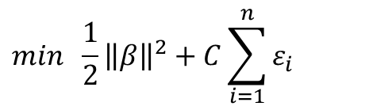

Support Vector Machines
Support Vectors:
$$ε_{i}$$
$$min \frac{1}{2}{\left\|β\right\|}^{2}+C\sum_{i=1}^{n}{ε_{i}}$$
$$M$$
s.t.
$$M$$
$$β_{0}+β^{T}∙x=0$$
$$ε_{i}$$
$${y_{i}(β}_{0}+x_{i}^{T}β )≥1−ε_{i}, i=1,..,n$$
$ε_{i} ≥0$ $, i=1,..,n$

Slide 24
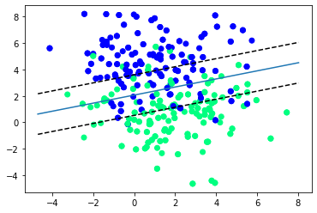
Suppor Vector Machines. Example
Impact of C parameter: Try C=1 and C=0.0001 in the script Example.py
C=1

Slide 25
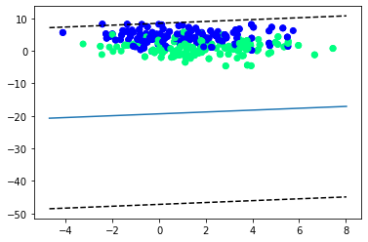
Support Vector Machines. Example
Impact of C parameter: Try C=1 and C=0.0001 in the script Example.py
C=0.0001

Slide 26
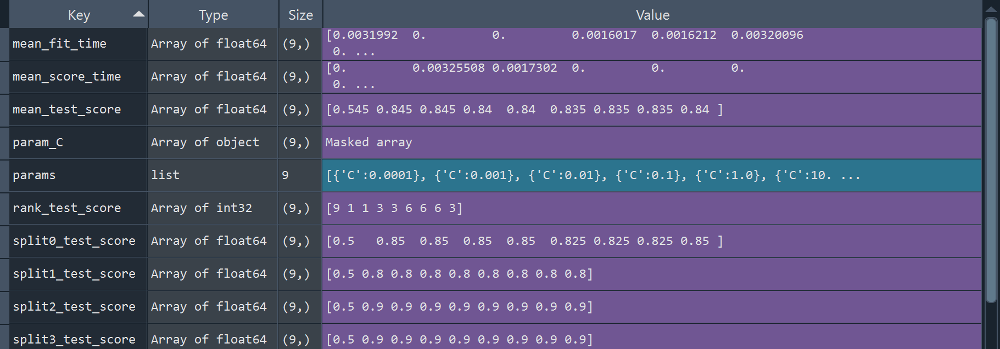
Support Vector Machines
Impact of C parameter: Fixed by cross-validation.

Slide 27
Support Vector Machines
Complete Exercise 1
You have data from the maintenance of an equipment under two conditions: ‘normal’ and ‘fault’.
Complete the code using linear SVM.

Slide 28
Support Vector Machines
Dual formulation
$$\max{L_{D}=\sum_{i=1}^{n}{α_{i}−\frac{1}{2}\sum_{i=1}^{n}{\sum_{i=1}^{n}{α_{i}α_{k}y_{i}y_{k}x_{i}^{T}x_{k}}}}}$$
Input feature via inner products
s.t.
$$\sum_{i=1}^{n}{α_{i}y_{i}=0}$$
$${0≤α}_{i}≤C, i=1,..,n$$

Slide 29
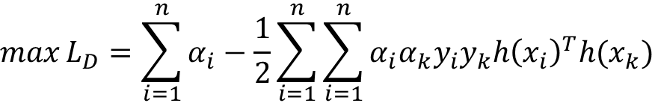
Support Vector Machines
Dual formulation
$$\max{L_{D}=\sum_{i=1}^{n}{α_{i}−\frac{1}{2}\sum_{i=1}^{n}{\sum_{i=1}^{n}{α_{i}α_{k}y_{i}y_{k}{h\left(x_{i}\right)}^{T}h(x_{k})}}}}$$
We move to a higher dimensional space (feature space) in cases when we cannot fully separate data with input space.
s.t.
$$\sum_{i=1}^{n}{α_{i}y_{i}=0}$$
Kernel functions
$${0≤α}_{i}≤C, i=1,..,n$$

Slide 30
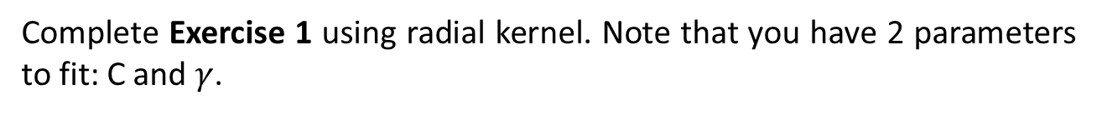



Support Vector Machines
Popular Kernel functions
Polynomial:
Radial basis:
Neural Network:
$$K(x_{i}{,x}_{k})={(1+ \left\langle x_{i}{,x}_{k}\right\rangle )}^{d}$$
$K(x_{i}{,x}_{k})={exp⁡(−γ\left\|x_{i}{−x}_{k}\right\|}^{2}$)
$K\left(x_{i}{,x}_{k}\right)=tanh⁡(k_{1}\left\langle x_{i}{,x}_{k}+k_{2}\right\rangle )$)
Complete Exercise 1 using radial kernel. Note that you have 2 parameters to fit: C and $γ$.

Slide 31
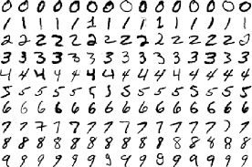
Support Vector Machines
Complete Exercise 2 using both linear and radial kernel.
MNIST database with handwritten digits

Slide 32
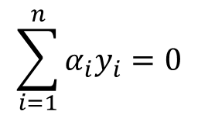
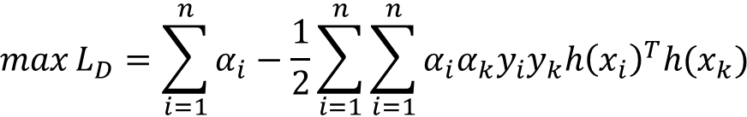
Support Vector Machines
$$\max{L_{D}=\sum_{i=1}^{n}{α_{i}−\frac{1}{2}\sum_{i=1}^{n}{\sum_{i=1}^{n}{α_{i}α_{k}y_{i}y_{k}{h\left(x_{i}\right)}^{T}h(x_{k})}}}}$$
s.t.
$$\sum_{i=1}^{n}{α_{i}y_{i}=0}$$
$${0≤α}_{i}≤C, i=1,..,n$$
Kernel Trick: we can work directly with inner products.

Slide 33


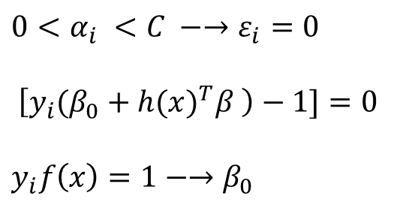
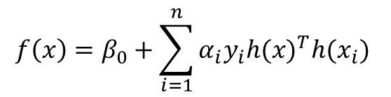
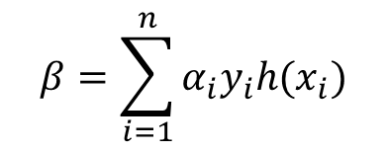
Support Vector Machines
Kernel Trick: we can work directly with inner products.
$$f\left(x\right)=β_{0}+h({x)}^{T}β$$
$$f\left(x\right)=β_{0}+\sum_{i=1}^{n}{α_{i}y_{i}h({x)}^{T}h(x_{i}) }$$
$$β=\sum_{i=1}^{n}{α_{i}y_{i}{h(x}_{i})}$$
$${0<α}_{i} <C −→ε_{i}=0$$
$$\left[{y_{i}(β}_{0}+h({x)}^{T}β \right)−1]=0$$
$$y_{i}{f\left(x\right)=1−→β}_{0}$$
$$β_{0}$$

Slide 34
Support Vector Machines. Example 2
Kernel Trick: Particularly useful to learn similarity data (text, molecular sequences, etc)
Consider Example2.py

Slide 35
Support Vector Machines
Exercise 3: We have a CSV file where a list of words is provided with their corresponding labels: {V: ‘verb’; N:’Non-verb’}.
Assess the Word2vec function, implemented in the package gensim (https://radimrehurek.com/gensim/models/word2vec.html), which takes a text corpus as input and produces the word vectors as output. It was developed by the Google team: https://code.google.com/archive/p/word2vec/. The original paper is attached in the folder.
In the Python script provided in the folder (Exercise3.py), you have an example Word2vec model and precomputed word vectors taken from the downloader API of gensim (https://github.com/piskvorky/gensim-data), particularly obtained from Google news (‘word2vec-google-news-300’).

Slide 36
Support Vector Machines
Exercise 3: We have a CSV file where a list of words is provided with their corresponding labels: {V: ‘verb’; N:’Non-verb’}.
Identify common words between the word2vec model and words included in the words_data.csv in folder data.
Apply Support Vector Machines with different kernels to predict whether common words are verbs or not. Use 80% for training (5-fold cross-validation) and 20% for testing.

Slide 37
Supervised Learning - SVM
Machine Learning
F.J. Planes fplanes@tecnun.es
17/10/2024

